Slide 1
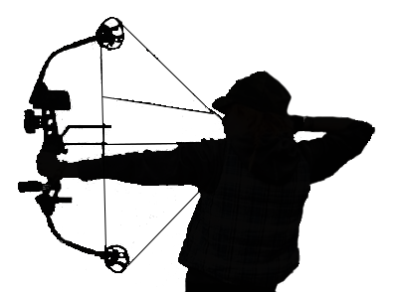
BUCK LEWIS AND SOUTHERN ARIZONA
RENDEZVOUS 3-D ARCHERY TOURNAMENTS
HOSTED BY:
HUACHUCA MOUNTAIN ARCHERS & BOWHUNTERS CLUB
MARCH 5 – 6, 2016
AT GARDNER CANYON
(28 MILES SOUTH OF TUCSON, AZ. OFF HWY 83 – SEE MAP ON REVERSE)
REGISTRATION
Early registration: Friday 5:00 P.M. – 7:00 P.M. Registration: Saturday 7:00 A.M. – 5:00 P.M.
Ranges open at 7:00 A.M. on Saturday & Sunday. NO SHOOTING BEFORE THIS TIME.
Ranges close at 5:00 P.M. on Saturday
Sunday, Ranges close at 12:30 P.M. Score cards MUST BE TURNED IN BY 1:00 P.M.
SMOKER ROUND, COON SHOOT
Shoot the Smoker Round Saturday or Sunday, but only one winner for the weekend.
Coon Shoot will be held Saturday at 7 P.M.
PRIMITIVE CAMPING, FIRST COME FIRST SERVE, NO DESIGNATED CAMPING;
PORTA-JOHNS ON SITE, LOTS OF PARKING, NOVELTY SHOOTS
ENTRY FEES
ADULTS (18 & OLDER) - $25.00; YOUNG ADULT (14-17) & YOUTH (11-13) - $10.00
CUBS (8-10) AND PEE WEE – FREE; FAMILY GROUP - IMMEDIATE FAMILY ONLY: $50
Menu
Breakfast : Breakfast Burrito, Coffee
Lunch/Dinner: Hamburgers, Hot dogs, etc…
Snacks: Chips, etc…
Drinks: Assorted drinks and water
Available: Saturday from 7 A.M. to 6 P.M.,
Sunday from 7 A.M. to 2 P.M.
Male and Female CLASSES
COMPOUND: SENIORS (62 AND OLDER)
OPEN – UNLIMITED – HUNTER – RANGEFINDER – LIMITED – BAREBOW -YOUNG ADULT – YOUTH – CUB – PEE WEE
TRADITIONAL: SENIOR (62 AND OLDER)
SELFBOW (WOOD ARROWS ONLY)
LONGBOW & RECURVE (ANY TYPE OF ARROWS)
YOUNG ADULT – YOUTH – CUB – PEE WEE (ANY TRADITIONAL EQUIPMENT)
FOR MORE INFORMATION CONTACT:
BOB FORD @ (520) 249-8613 / hmabc@cox.net
Alycia Sheley @ (520) 678-2992/ hmabc_secretary@huachuca-archers.com
WWW.HUACHUCA-ARCHERS.COM

Slide 2
Directions
Follow the map below from the East, West or North: Travel I-10 to Sonoita exit #281, Highway 83 South. Proceed south approximately 22 miles to Gardner Canyon Rd., located between milepost 37 & 38. Turn right onto Gardner Canyon Rd. and follow the signs approximately 3.5 miles to shoot sight.
From the South: Travel Highway 82 to Sonoita. Turn north on Highway 83 and go 4.5 miles to Gardner Canyon Rd. Turn left on Gardner Canyon Rd. and follow the signs approximately 3.5 miles to shoot sight.
Left at the fork
I-10
Right at the fork
Right at the fork
Right at the fork
Take the first right
Sonoita

