Slide 1
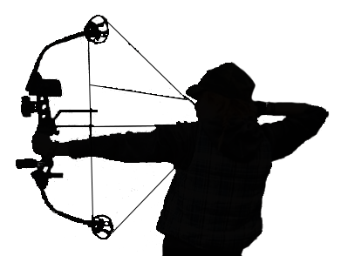
Huachuca Mountain Archers and Bowhunters Club
Family 3D Archery Tournament
HOSTED BY: HUACHUCA MOUNTAIN ARCHERS AND BOWHUNTERS CLUB
www.Huachuca-archers.com
MARCH 11-12, 2023
AT GARDNER CANYON
(28 MILES SOUTH OF TUCSON, AZ. OFF HWY 83 – SEE MAP ON REVERSE)
REGISTRATION
Friday: 5:00 PM – 7:00 PM
Saturday: 7:00 AM – 5:00 PM
Sunday: 7:00 AM – 10:00 AM
No Shooting before or after below times:
7:00 AM - 5:00 PM on Saturday
7:00 AM - 12:30 PM on Sunday.
SCORE CARDS MUST BE TURNED IN BY 1:00 PM ON SUNDAY TO BE COMPETITIVE
CHANGE TO SHOOTING CLASSES
WE HAVE CHANGED SHOOTING CLASSES AND SOME RULES. CHECK THEM OUT ON OUR WEBSITE AND FACEBOOK PAGE.
FOOD AND DRINKS
WE ARE NOT PROVIDING FOOD THIS YEAR. HOWEVER, BOTTLED WATER WILL BE AVAILABLE FOR PURCHASE.
ENTRY FEES
Adults (18 & older) - $30.00
Youth (14-17) - $15.00
Cub (10-13) & Pee Wee (9 and under) - Free
Family Group: Parent(s) with kids 17 and under - $65 ($10 or more savings)
COURSE LAYOUT
SHOOT AS A FAMILY. TRADITIONAL AND COMPOUND SHOOT THE SAME 4 COURSES OF 15 TARGETS.
SMOKER ROUND.
CLASSES
COMPOUND: M/FBSR (62+), M/FBO, M/FBR, KM/FO, M/FBHF, KHCM/F, YM/F, CM/F, PW
TRADITIONAL: M/FSTRD (62+), M/FTRD, M/FYTRD, CM/F, PW
MUST HAVE AT LEAST 3 SHOOTERS PER CLASS OR MOVE UP TO NEXT CLASS
PRIMITIVE CAMPING
FIRST COME FIRST SERVE FOREST SERVICE DRY CAMPING, LOTS OF PARKING, PORTA-POTTIES ON SITE.
FOR MORE INFORMATION CONTACT:
Conrad Sheley @ (520) 678-2283 / hmabc@cox.net
Randy Oliver @ (520) 249-1045

Slide 2
Directions
From the East, West, or North: Travel I-10 to Sonoita Exit #281, Highway 83 South. Go south approximately 22 miles to Gardner Canyon Rd, located between milepost 37 & 38. Turn right on Gardner Canyon Rd and follow the signs approximately 3.5 miles to shoot site.
From the South: Travel Highway 82 to Sonoita. Turn north on Highway 83 and go 4.5 miles to Gardner Canyon Rd. Turn left on Gardner Canyon Rd and follow the signs approximately 3.5 miles to shoot site.
Left at the fork
I-10
Right at the fork
Right at the fork
Right at the fork
Take the first right
Sonoita

